Slide 1
Classification of Facebook Newsfeeds and Sentiment Analysis

Slide 2






News Feed
Flow of our proposed classification system
Friends Posts
Classifier
Guys watch the trailer of this new movie
Post: Twinkle Twinkle Little star
Tag Classifier
Entertainment Posts
Life Event Posts
Post: Twinkle Twinkle Little star
Guys watch the trailer of this new movie
.
.
.
Liked Page Posts
.
.
.
Sentiment Analysis

Slide 3
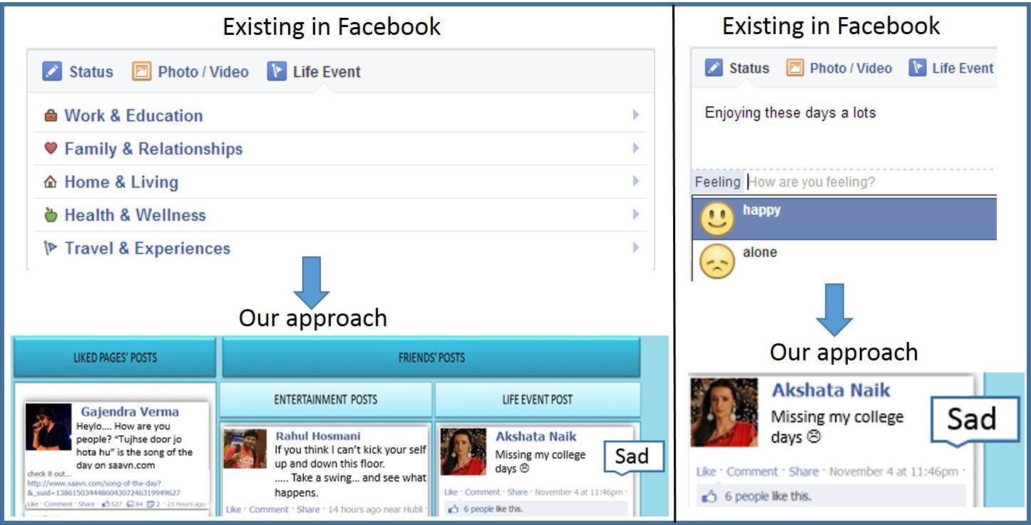
Facebook Existing Features Versus Our Approach

Slide 4
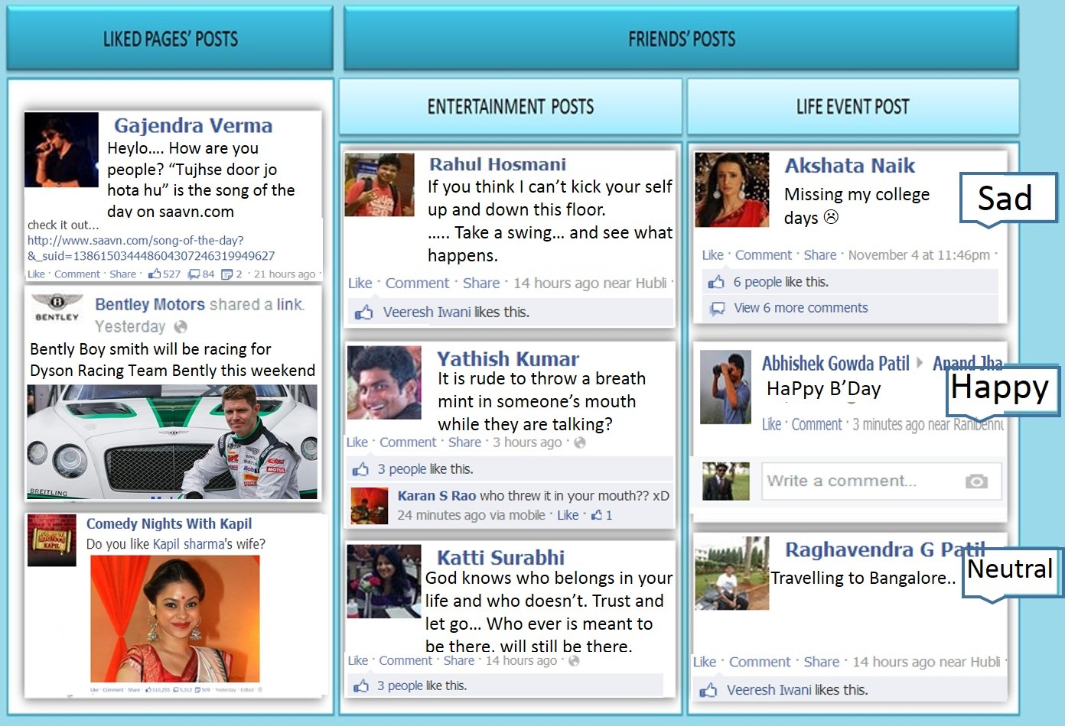
Prospective
Classified Facebook Data

Slide 5
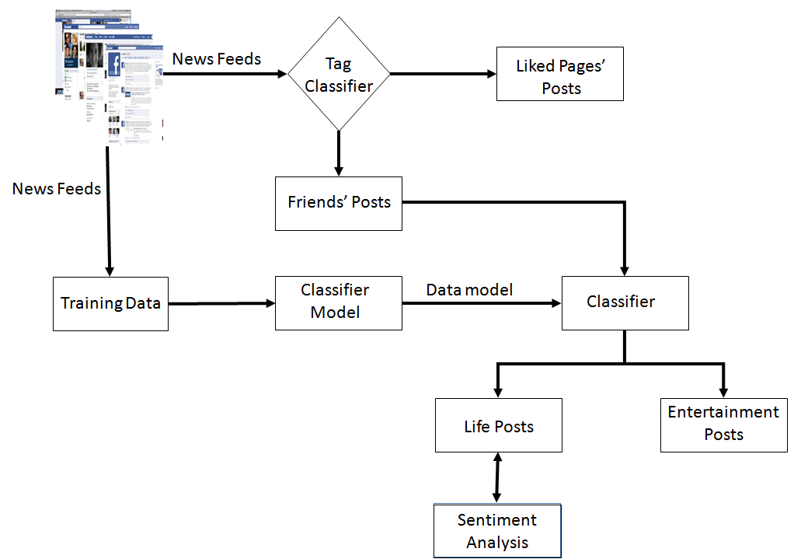
Proposed Work
Model showing classification and sentiment analysis of facebook news feeds

Slide 6









Data Extraction

Slide 7

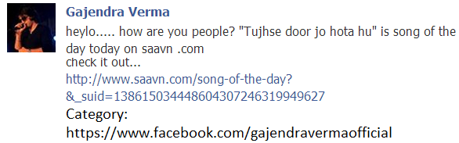
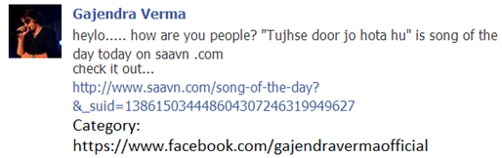









Classification
Classified as like pages’ post
Weka Classifier
Yes
Is Null?
No
Our Learning Model

Slide 8








Sentiment Analysis
SentiWordNet
Dictionary
Is –ve?

Slide 9
Results
Accuracy of Classification Algorithms
Algorithms | Accuracy
Bayes Net | 94.69%
J48 | 93.73%
Naïve Bayes | 92.70%
SVM | 94.75%
Logistic Regression | 92.71%

Slide 10
Results
Comparison of Accuracy using Weka and Learning Model-Training Data Set 1
No of posts | Weka’s SVM | SVM Learning Model | Weka’s Logistic Regression | Logistic Regression Learning Model
200 | 93.60% | 98.50% | 93.01% | 93.50%
400 | 93.69% | 98.50% | 92.70% | 91.50%
600 | 93.46% | 97.66% | 91.10% | 86.50%
800 | 93.51% | 97.75% | 91.93% | 85.60%
1000 | 93.47% | 97.13% | 91.31% | 83.85%

Slide 11
Results
Comparison of Accuracy using Weka and Learning Model-Training Data Set 2
No of posts | Weka’s SVM | SVM Learning Model | Weka’s Logistic Regression | Logistic Regression Learning Model
200 | 93.44% | 98.50% | 89.94% | 71.50%
400 | 93.22% | 97.75% | 91.97% | 73.50%
600 | 93.00% | 97.16% | 90.98% | 68.83%
800 | 92..96% | 96.50% | 92.99% | 70.35%
1000 | 92.96% | 96.10% | 92.49% | 73.40%

Slide 12
Results
Comparison of Accuracy using Weka and Learning Model-Training Data Set 3
No of posts | Weka’s SVM | SVM Learning Model | Weka’s Logistic Regression | Logistic Regression Learning Model
200 | 92.84% | 97.48% | 92.49% | 64.82%
400 | 92.97% | 96.49% | 95.00% | 60.65%
600 | 92.85% | 96.82% | 91.78% | 62.93%
800 | 93.37% | 96.37% | 91.48% | 64.20%
1000 | 93.68% | 96.60% | 92.24% | 63.80%

Slide 13
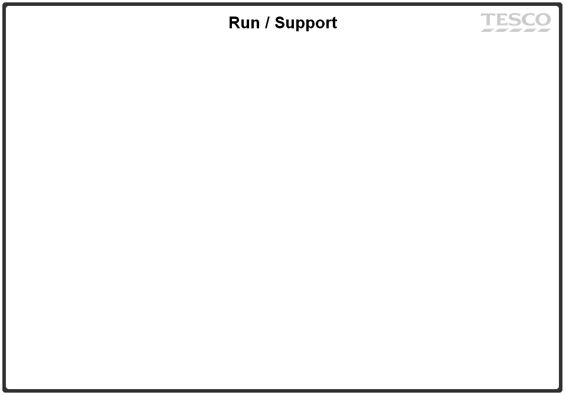
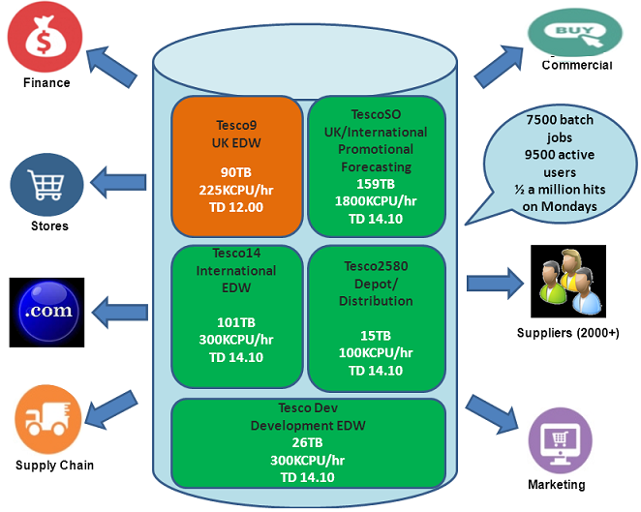
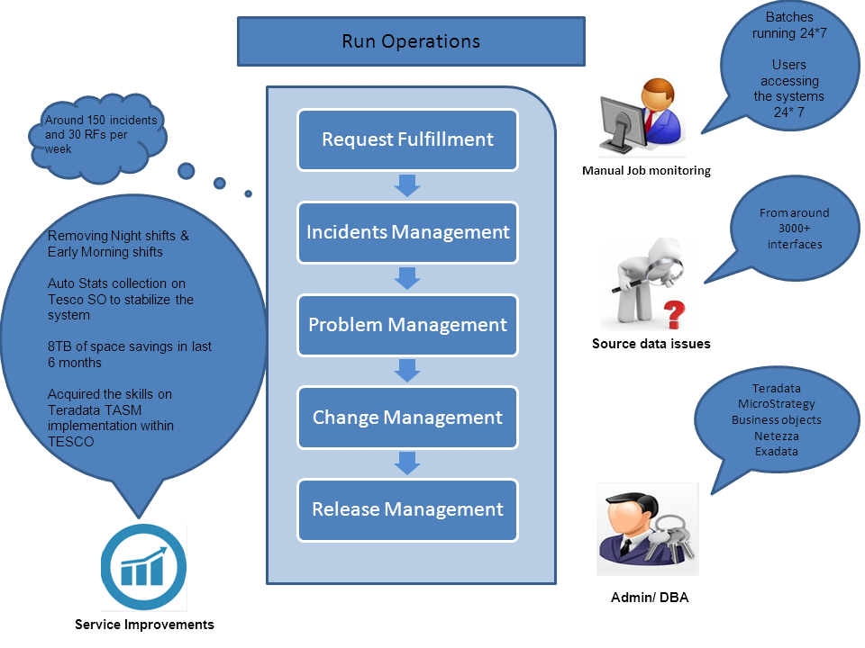
Data Warehouse Infrastructure
To Be
Tesco16
UK/International EDW
333TB
TD v15.1
TescoSO
UK
Promotional Forecasting
159TB
1800KCPU/hr
TD v14.1
Tesco14
UK/International
Backup
101TB
300KCPU/hr
TD v14.1
Tesco15
International
Promotional Forecasting
17TB
TD v15.1
Tesco Dev
Development EDW
26TB
300KCPU/hr
TD V14.1

Slide 14







Touch points with Digital Product Team
HADOOP CLUSTER
Teradata Servers
Ab-initio
Customer, Coupons, Offers
Sales
Wherescape
Mainframe Servers
SFG
Click Stream
Archived Data
Sqoop
Adobe – Third Party
CPU
CPU Intensive Processing

Slide 15
















Hadoop Eco System
Name Node
(Active)
Name Node
(Stand By)
YARN
DN1
DN2
DN3
1
2
3
1
2
3
1
2
3
RDBMS

Slide 16


What Have We Built
UNIX
TERADATA
.SH
TDPM
TDPN
TDPS
HADOOP
SQOOP
HDFS
HIVE
Notes:
Data → Information → Knowledge → Decision Making

